Slide 1
Analyzing Chicago Taxi Cab Data
BUS 41204: Machine Learning Final Project
Joseph Jacobs, David Pilla, Zak Whichard

Slide 2
The Dataset

Slide 3
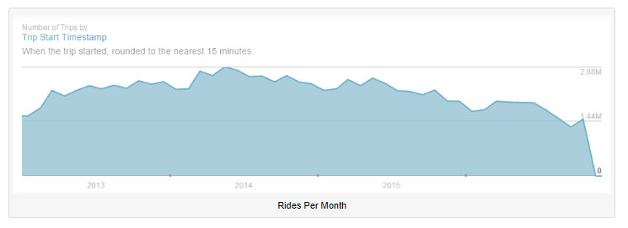
Chicago Taxi Trip Dataset
113M Taxi Cab Trips
Covers period from Jan 2013 through Sept 2016
23 Variables (Taxi ID, Start/End Date-Time, Duration, Distance, Pickup/Dropoff CCA (2 of 10 location variables), Fare, Tips, Tolls, Extras, Total, Payment Type, Company)

Slide 4
CCA (Chicago Community Area) Dataset

Slide 5
Data Cleaning and Exploration

Slide 6
[Describe fields added, modified, dropped, or filtered]

Slide 7
[Describe stats on some factors]
[Include notes on number of companies, rides per company, number of trips per pickup/dropoff area]

Slide 8
Deciding on an initial sample size
[Describe analysis of unique cab IDs as a function of sample size.]

Slide 9
Data Analysis

Slide 10
Unsupervised Learning: Cluster Analysis

Slide 11
[summarize work done on cluster analysis]
[describe method used and package]

Slide 12
Supervised Learning: Modeling Tips

Slide 13
Hypothesis
By building a model that predicts tips using actionable factors we can try to isolate profitable driver strategies.

Slide 14
First Model
Decision tree

Slide 15
Supervised Learning: Modeling Tips

